Slide 1
Missing Opportunity: Migrants and Refugees
Training Course
Gaziantep, Turkey
18.06.2018 – 24.06.2018

Slide 2
Table of contents
Page 3-4 ………………… Introduction
Page 5-6-7-8 ………………… Summary of the project
Page 9-10 ………………… Participant’s profile
Page 11 ………………… Additional important information
Page 12-15 .………………. Accomodation
Page 16-20 ………………… How to reach
Page 21-23 ………………… Reimbursment
Page 24-27 ………………… Other useful information
Page 28 ………………… Selection Date’s
Page 29 ………………… Contact Informations

Slide 3
In this info pack you can find information about project, logistics and other useful information. Please read carefully. If you have some questions, do not hesitate to ask us via e-mail sofdagi@hotmail.com

Slide 4
WARNING!
Please don’t forget this isn’t holiday and we need some responsibilities. Thank you for understanding.
If we’re asking you to come at fixed time for beginning of session, please, be responsible and respect organizers of this training course.
Respect other participants of the Training Course
Take active participation in activities, which was prepared especially for you
Be polite, open minded and smile!

Slide 5
Summary
We’re sure, that In nowadays life we have to face with such things, as unequality, mistrust, racism, bigotry and selfishness, but also we’re sure that by informing youth about such problems and letting them use effective instruments we can build new society, where all those bad things will melt step by step, until they finally gone.
The main goals of the training, is to provide effective tools for participants, getting them know the topic of refugees and migration and providing with skills, which later they can share and teach to other people in their local communities and Countries, through analysis of the best practices of the world, by presenting it with personal experiences and reflections of the participants. Information will be provided about reality of refugees question in different countries, and this will be for understanding of the topic from different points of view.
The training will be facilitated with 2 experienced trainers and supported with 1 coordinator and 2 members of logistic team.

Slide 6
Throughout the last two decades, the world has been witnessing the largest number of immigrants since World War II. UNHCR reports suggest that the number of immigrants has reached to 65.3 Million by the end of 2015 and 24 people become immigrants every minute in some part of the world. Since the refugee crisis started, more then 1.000.000 entered Europe, and a high percentage of them were young people between 13-30 years old. European countries are looking for different ways and approaches to deal with this situation. Supporting measures and all kinds of (local) initiatives have been developed. On the other hand reactions of fear, exclusion, xenophobic opinions and a neglection of the basic human rights of these newcomers are a reality we face in all parts of Europe. But at the same time past experience of Western European countries has shown that when properly integrated, immigrants from outside the EU can have a positive effect on those countries. Considering the fact that populations in Eastern European countries are contracting, these people have a potential to share the burden of labour, especially when the number of pensioners in a country is rising and the number of working-age people is decreasing.
In this context, Erasmus + Programme provides efficient tools for the youth sector, which can encourage and provide technical/methodological/financial support for migrants as they design their own solutions for the issue.
This training course wants to discuss the main issues and challenges in fostering inclusion of reugees and (newly arrived) migrants. Exploring the role of the youth worker in this process, raising awareness on the topic towards young people, exchange of good practices and tools/methods are some of the themes we will tackle during this training course.

Slide 7
The main objectives are:
• to present deeper information on the basic concepts and existing context related to migration and refugees in Europe.
• to increase knowledge and awareness of the participants on contemporary problems and challenges related to migration, migrants and refugees.
• to provide information on how to use project based methodologies for analysing the problems of refugees/ migrants and developing targeted solutions.
• to provide information on how to use Erasmus + Programme for innovative and project-based solutions on the issue of migration.
• to explore the role(s) of a youth worker in the inclusion process of refugees and (newly arrived) migrants and in the process of raising awareness
• to equip youth workers with effective tools and methods for trainings and activities on young refugees and migrants
• to improve youth organizations’ capacity to work for/with migrants and refugees.
• to develop Europe-wide partnerships for further Erasmus + projects of the youth sector related to migration, migrants and refugees.
• to exchange information and realities in the different countries of the participants to get a deeper understanding of the diversity of this topic

Slide 8
Programme support on the topic of project:
The Erasmus+ programme in the field of youth promotes fairness and inclusion for participants from disadvantaged backgrounds and with fewer opportunities (such as migrants or refugees) through specific support, priority setting and targeted use of funds.The Erasmus+ "Inclusion and Diversity Strategy " is designed to ensure that the programme works for disadvantaged young people to the greatest extent possible. The integration of migrants and refugees is an additional target for 2017.
Tolerance, mutual understanding and the fight against racism and xenophobia are important objectives for Erasmus+.
Policy Support on the topic of project:
-Social inclusion of all young people, including those from a migrant background, is a key aim of the EU Youth Strategy (2010-2018).
-European Commission are prioritising the integration of young people with a migrant background, including newly-arrived migrants and refugees.

Slide 9
Participant’s profile
This project will be held from 18th to 24th of June 2018, in Gaziantep, Turkey with the participation of 24 people from 6 different countries, for each country 3 participants with no age limit.
You will stay in Safir Hotel, in one room with two more participants. The accommodation and your flight will be covered by the Sof Mountain Youth and Sports Club Association
Remember that we want you to participate in all activities, active participation is mandatory while all of the proposed activities during the course.
All participants are required to fill up this form by the link

Slide 10
Participant’s profile
Country | How many people
United Kingdom | 3
Greece | 3
Italy | 3
Norway | 3
Romaia | 3
Spain | 3
Turkey | Turkish Participants already chosen

Slide 11
Additional important information
Language: while training we will use English language
Dress code: no dress code
Clothes type: according to weather(look chapter Other useful information of this info kit)
Clothes: Slippers, if you think that you need
Costs: there’s no participation fee
Tickets: try to by both tickets(here and back) at once
Tickets: Send us your tickets, as you bought them
Medicaments: take it with you, if you know, that you might need it
Insurance: take your insurance card with you
Attention: prepare your staff beforehand and be sure, that you did not forget something

Slide 12
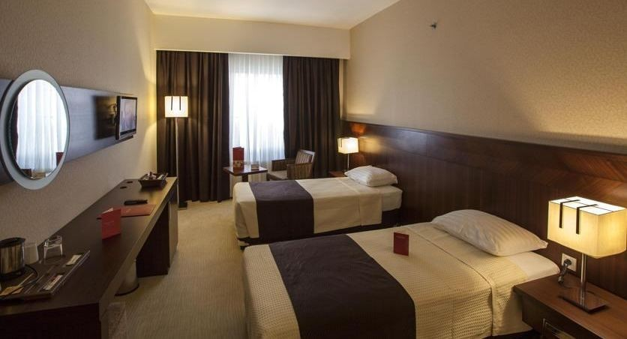
Accommodation
Safir Hotel Adress and link: Safir Hotel, Sani Konukoğlu Bulvarı No : 38 ( İpekyolu ) Pk: 27500 Şehitkamil, 27500

Slide 13
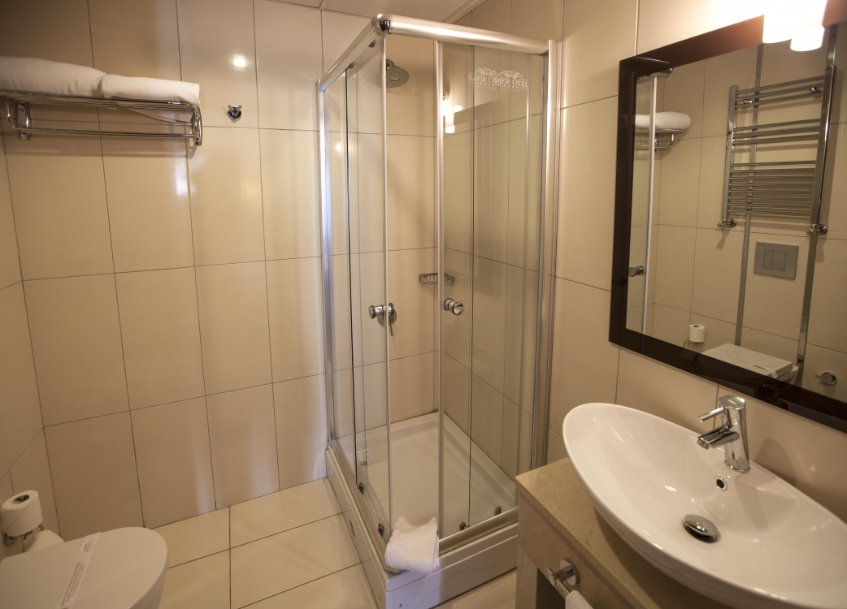
Accommodation

Slide 14
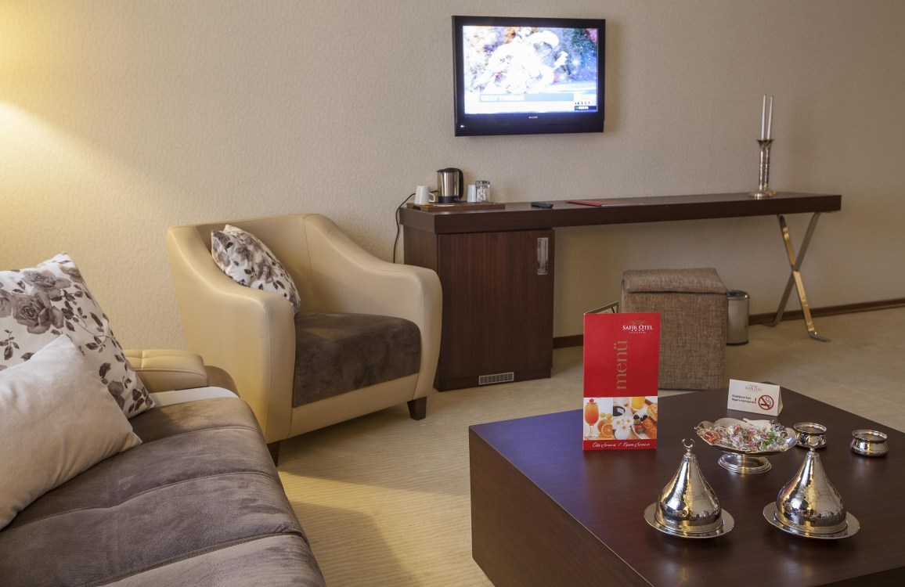
Accommodation

Slide 15
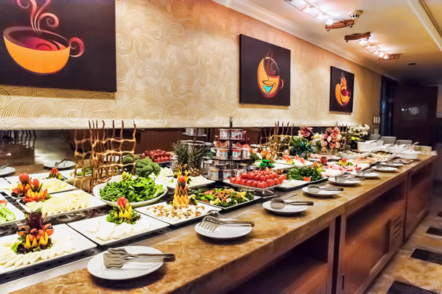
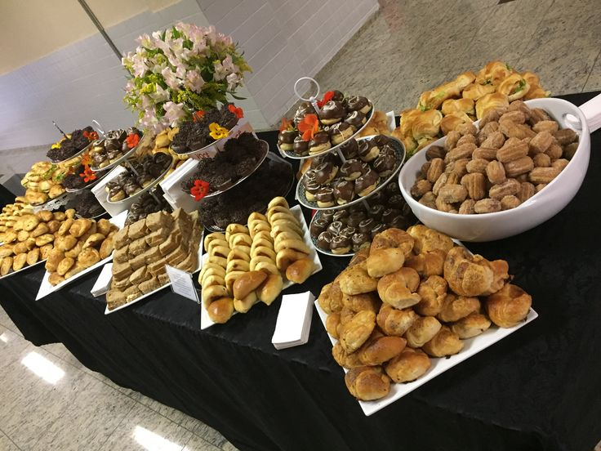
Accommodation
Food will be provided 3 times per day + 2 coffee breaks

Slide 16
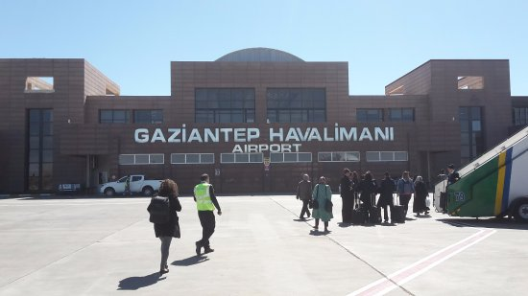
How to reach?
Airport located out of Gaziantep

Slide 17
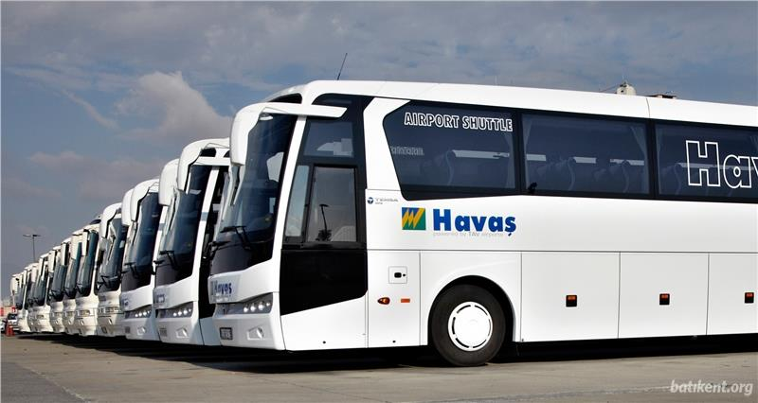
How to reach?
From the Airport you will have to take local bus, called Havaş. The price of one ticket is 9 TL

Slide 18
How to reach?
Show this to drivers:
Havaş ofis merkezinde ineceğim?
And you will get to central Havas Office

Slide 19
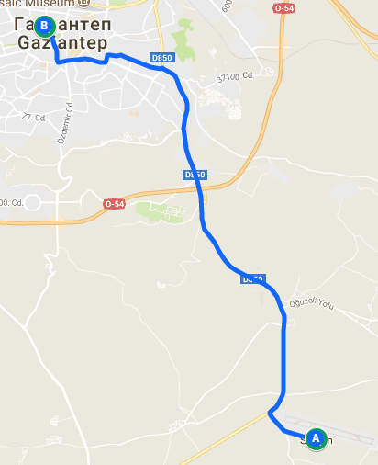
How to reach?
From Central office bus stop we will take you by car and drive directly to your Hotel
Wait for us in the office of Havaş
By this link of Google Maps you will see more details, which may help you

Slide 20
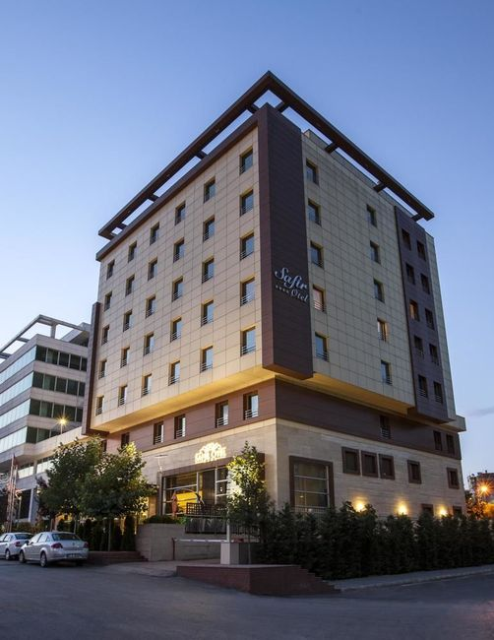
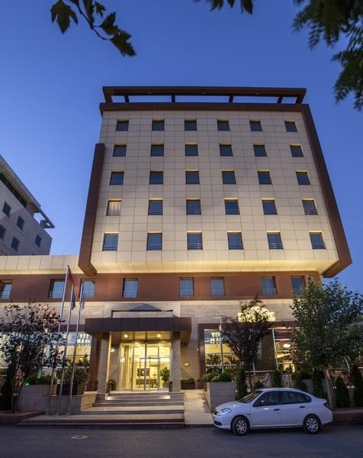
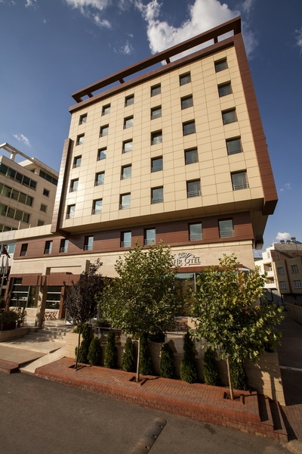
How to reach?
Here’s your Hotel

Slide 21
Reimbursement
The reimbursement of travel costs will be to the rules of the Erasmus + Programme. We will reimburse money according to provided originals of invoices/tickets/boarding passes. Money will be given in EURO, up to the currency of money in your country.
If you will provide us boarding passes or any other invoices, we can pay you in cash directly after your arrival. If you will send only copy of e-mail or on-line check in from flight company, we will reimburse it via bank transfer after project is finish.

Slide 22
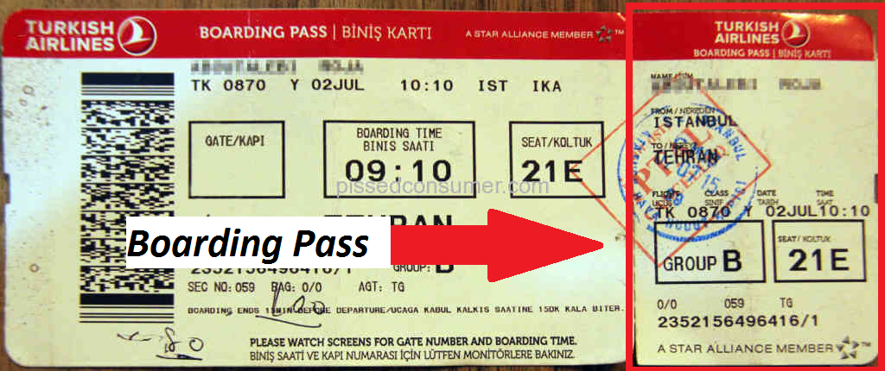
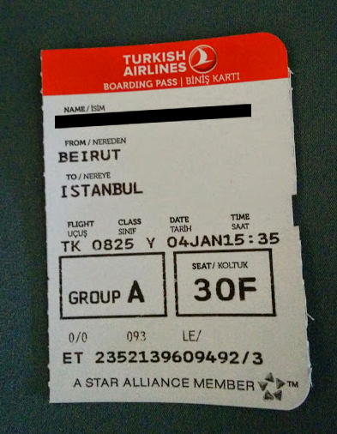
Reimbursement
Here‘s the boarding pass from flight, which we will need.

Slide 23
Reimbursement
Reimbursment by distance. Distance calculator: Calculator
Countries | EUR per participant
Italy | 360
United Kingdom | 530
Norway | 530
Spain | 530
Greece | 275
Romania | 275

Slide 24
Other useful information
VISA
To enter Turkey, you need a valid identity document (passport or identity card).
Whether you need a Visa for entry depends on your nationality. United Kingdom and Spain needs visa and Some citizens of
Other countries does not need a Visa.(Please check before buy ticket)
If you need a Visa, make sure you apply for it immediately by internet
with eVisa website

Slide 25
Other useful information
Euro(EUR) – Turkish Lira(TL) currency
(EUR) - (TL) currency

Slide 26
Other useful information
Weather in Gaziantep for next 10 days
If you hesitate, which clothes to take with you, check This website Gaziantep Weather

Slide 27
Other useful information
There will be cultural nights, so you can take something special from your country:
Food
Drinks(also, alcohol drinks)
Any traditional, cultural or just interesting things

Slide 28
CONTACT INFORMATION
Adress: 27090 Değirmiçem Mah. Ökkeş bahri cd No:34 Şehitkamil /Gaziantep/Turkey
E-mail: sofdagi@hotmail.com
WEB: SofDagi website
COORDINATORS AND TRAINER CONTACTS: Faruk ERBAGCI
Gsm : +90 532 273 2842 +90 507 191 4921 E-Mail : sofdagi@hotmail.com
Yusuf Yıldırım
Gsm : +90 505 429 1265 E-Mail : sofdagi@hotmail.com

Slide 29
Selection Date
-Applicant should send their applicatipons till 02.05.2018
-We will send selection result(positive or negative) email to all applicants until 04.05.2018
-When you get answer, if you selected participant then you should confirm us your participations till 07.05.2018
-Selected participants should send us their travel ticket(we want purchased ticket, no reservation) till 18.05.2018

